Slide 1


Project Statistical Modelling
Zeynab Akolade

Slide 2
Project Goals
Data retrieval and Integration
Query Foursquare and Yelp APIs to gather points of interest (POIs) data around each bike station.
Comparative Analysis:
Compare the quality and coverage of information between Foursquare and Yelp APIs.
Data Visualization and Exploration
Visualize the bike station and POI data to gain insights and identify patterns.
Explore relationships between bike station attributes and POI attributes through graphs and plots.
Define and measure "coverage" based on metrics such as the number of POIs, reviews per POI.
Integrate bike station data and POI data into a structured format.

Slide 3
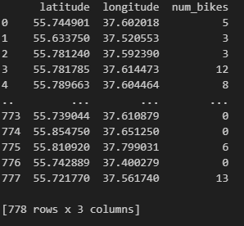
Parsing the URL to receive data to estimate available number of bikes in Moscow city

Slide 4
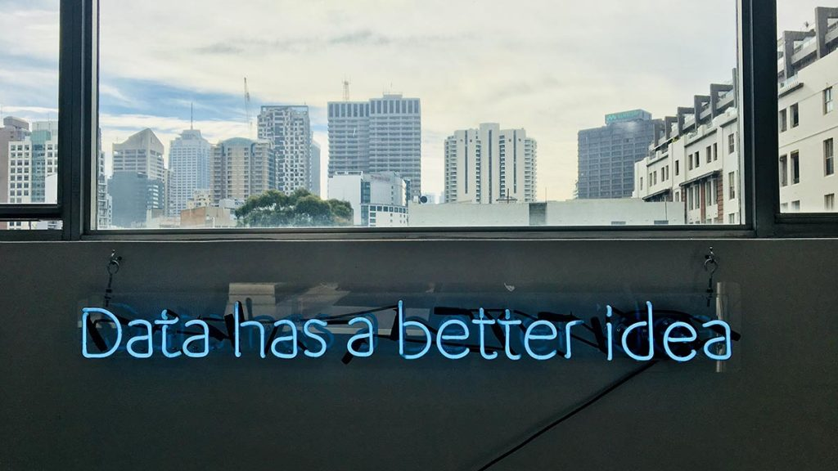
Project Flow Structure (The Process)
Define Classes
Data Preparation
Classification Model
Model Training
Model Evaluation
Interpretation and Insights
Communication and Reporting

Slide 5

The Result : Comparative quality of API coverage
Foursquare API:
This API provides a significant amount of POI data, especially for various types of venues like restaurants, cafes, and attractions.
It also offered detailed attributes such as ratings, review counts, and categories, which enriched the dataset with valuable information.
Foursquare seemed to have a comprehensive coverage of popular and diverse POIs.
Yelp API:
Yelp also contributed a substantial volume of POI data, including businesses like restaurants, cafes, and other points of interest.
Like Foursquare, Yelp API provided ratings, review counts, and categories for businesses, enhancing the dataset's content.
Yelp's data appeared to complement Foursquare's coverage and provided additional insights into local establishments.

Slide 6
Interpretation
The relationship between the total_bikes and location is significant, but the model is not a good fit for the data.

Slide 7



Challenges
Data Quality and Consistency
Data Cleaning and Preprocessing
Data Integration and Joining
Model Selection
Model Interpretation
Interpreting Insights

Slide 8

Future Goals
Propose potential improvements for the models, data collection process, or analysis methodology.
Consider how the project findings can be used for real-world applications or further research.

Slide 9

Thank you

